Slide 1
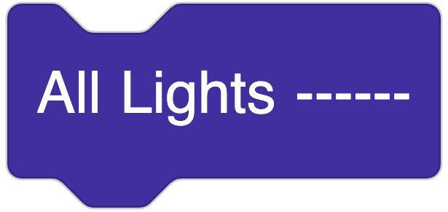
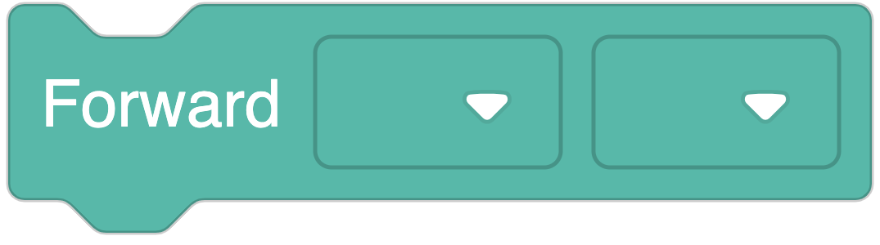
Challenge 1:
Stop light
Make Dash turn yellow.
Make Dash turn red.
Make Dash turn green.
Make Dash drive 35 + 63 = ____ cm. Round to the nearest 10.

Slide 2
Challenge 2:
Books
Find and measure two books. Book 1: ______ cm Book 2: ______ cm
Put the books next to each other. What is the total length? _______ cm + _______ cm = _______ cm
Program Dash to drive past both books. You might need to round to the nearest 10.

Slide 3
Challenge 3:
Backpack
Grab the backpack of one person in your group. Measure the height of the backpack. The backpack is _______ cm tall.
Program Dash to drive the height of the backpack.
How much further would Dash need to drive in order to go 120 cm all together? ____ cm + ____ cm = 120 cm

Slide 4
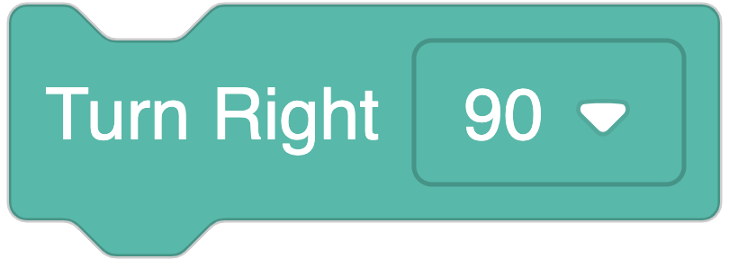
Challenge 4:
Square
Find a 2 by 2 square in the tiles on the floor and measure the sides. Each side is _______ cm.
Program Dash to drive around the perimeter of the square.
Use this each time you want to turn a corner

Slide 5
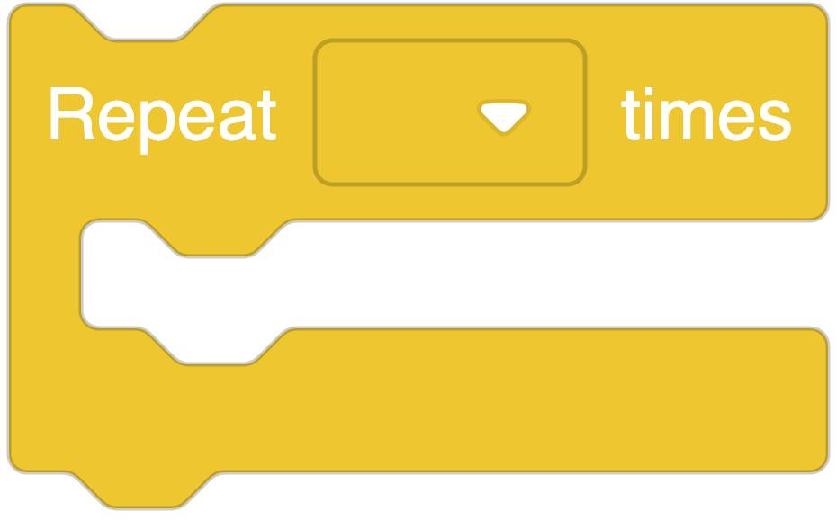
Challenge 5:
Loopy Square
Find a 3 by 3 square in the tiles on the floor and measure the sides. Each side is _______ cm.
Program Dash to drive around the perimeter of the square. This time, use only 3 blocks:

